Slide 1

Walmart Store Sales Forecasting using R-Programming
Suruchi Kumar (18070122072)
Vattikuti Sree Sahithi (18070122077)
Yashika Chhabaria (18070122079)
Arundarasi Rajendran (18070122081)

Slide 2

TABLE OF CONTENTS
Introduction
Problem Statement
Technology Used
Literature Survey
Applications
Methodology and Techniques
Dataset Explanation
Diagram flow
Results
Code Execution
Conclusion
References

Slide 3

Introduction
01
Walmart is an American multinational retail corporation that operates a chain of hypermarkets all around in the United States.
As of January 31, 2021, Walmart has 11,443 stores and clubs in 26 countries, operating under 54 different names.
Predicting future sales for a company is one of the most important aspects of strategic planning.
We are using R-programming as R is a programming language for statistical computing and graphics.
Notes:
It is really useful for our project since we are mostly working on statistical models and graphs and machine learning algorithms.
The R language is widely used among statisticians and data miners for developing statistical software and data analysis. Polls, data mining surveys, and studies of scholarly literature

Slide 4
Problem Statement
02
One challenge of modeling retail data is the need to make decisions based on limited history. If Christmas comes once a year, so does the chance to see how strategic decisions impacted the bottom line.
We are provided with historical sales data for 45 Walmart stores located in different regions. Each store contains many departments, and the sales for each department in each store must be projected.
To add to the challenge, selected holiday markdown events are included in the dataset. These markdowns are known to affect sales, but it is challenging to predict which departments are affected and the extent of the impact.

Slide 5

Technology used
03
R Libraries used
dplyr
broom
forecast
readr
tidyr
lubridate
glmnet
gbm
xts
Ggplot2
R programming
R studio

Slide 6
Literature Survey
04
Sr. No | Author(s) | Journal/Year | Title | Methodology | Key Findings
1 | Bohdan M. Pavlichenko | 2019, mpdi | Machine-Learning Models for Sales Time Series Forecasting | Using Machine learning, certain models were deployed to make time series forecast models such as Lasso regression, Random Forest, Neural networks, ARIMA, and ExtraTrees | • Stacking of machine learning models to give good results. • Stacking all ML models gave low range of error.

Slide 7
Sr. No | Author(s) | Journal/Year | Title | Methodology | Key Findings
2. | Archisha Chandel Akanksha Dubey Saurabh Dhawale Madhuri Ghuge | April 2019 | Sales Prediction System using Machine Learning | Linear Regression, XGBoost Regressor | In this model, a five-step procedure is used to solve the problem of predicting the Sales revenue for different products at different outlet locations
3. | Mr. Faraz Harayani Mrs. Haripriya | May 2020 | An effective approach for sales forecasting | Regression, Linear regression, Ridge regression, LASSO regression | Considered main approaches and case studies of using machine learning for sales forecasting.
4. | Sunitha Cheriyan Shaniba Ibrahim Saju Mohanan Susan Treesa | August 2018 | Intelligent Sales Prediction Using Machine Learning Techniques | Generalized Linear Model, Decision Tree, Gradient Boosted Trees. | Data mining techniques are very effective tools in extracting hidden knowledge from an enormous dataset to enhance accuracy and efficiency of forecasting.

Slide 8
Applications
05
01
Supply chain management
Early cost estimation
02
03
Resource Allocation
Better Decision Making
04
Notes:
Supply chain management - Forecasting can be used in supply chain management to ensure that the right product is at the right place at the right time. Accurate forecasting will help retailers reduce excess inventory and thus increase profit margin.
Cost estimation- Sales forecasting also helps businesses to estimate their costs and revenue accurately based on which they are able to predict their short-term and long-term performance.
Resource Allocation- Sales forecasting allows companies to efficiently allocate resources for future growth and manage its cash flow.
Better Decision Making- A sales forecast helps every business make better business decisions. It helps in overall business planning, budgeting, and risk management.

Slide 9

Methodologies/Techniques used
Time Series Forecasting using Arima(autoregressive integrated moving average)
06
First we determine the value of d
We first check the stationarity of the data. If the data is stationary, then d=0
If the data is trendy then we take the first difference and check for stationarity again. We keep taking differences until we get a stationary output. The number of difference required is the number
After determining d, we can utilize sample ACF (auto correlation) to get the AR order p. If the ACF cuts off after some lags, that number is the order of AR.
We can determine the MA order q by looking at the sample PACF (partial auto correlation) of the differenced data. If the PACF cuts off after some lags, that number is the order of MA.

Slide 10
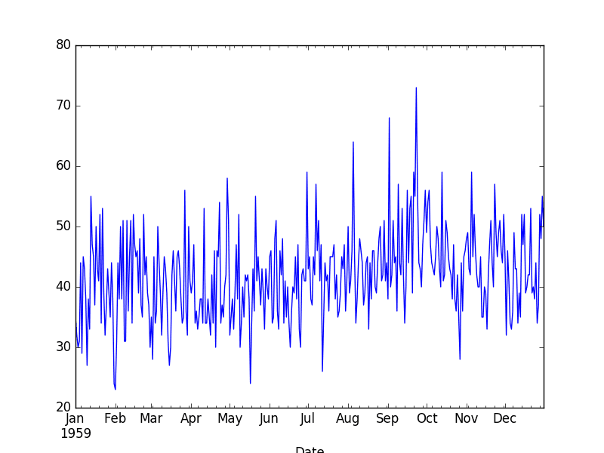
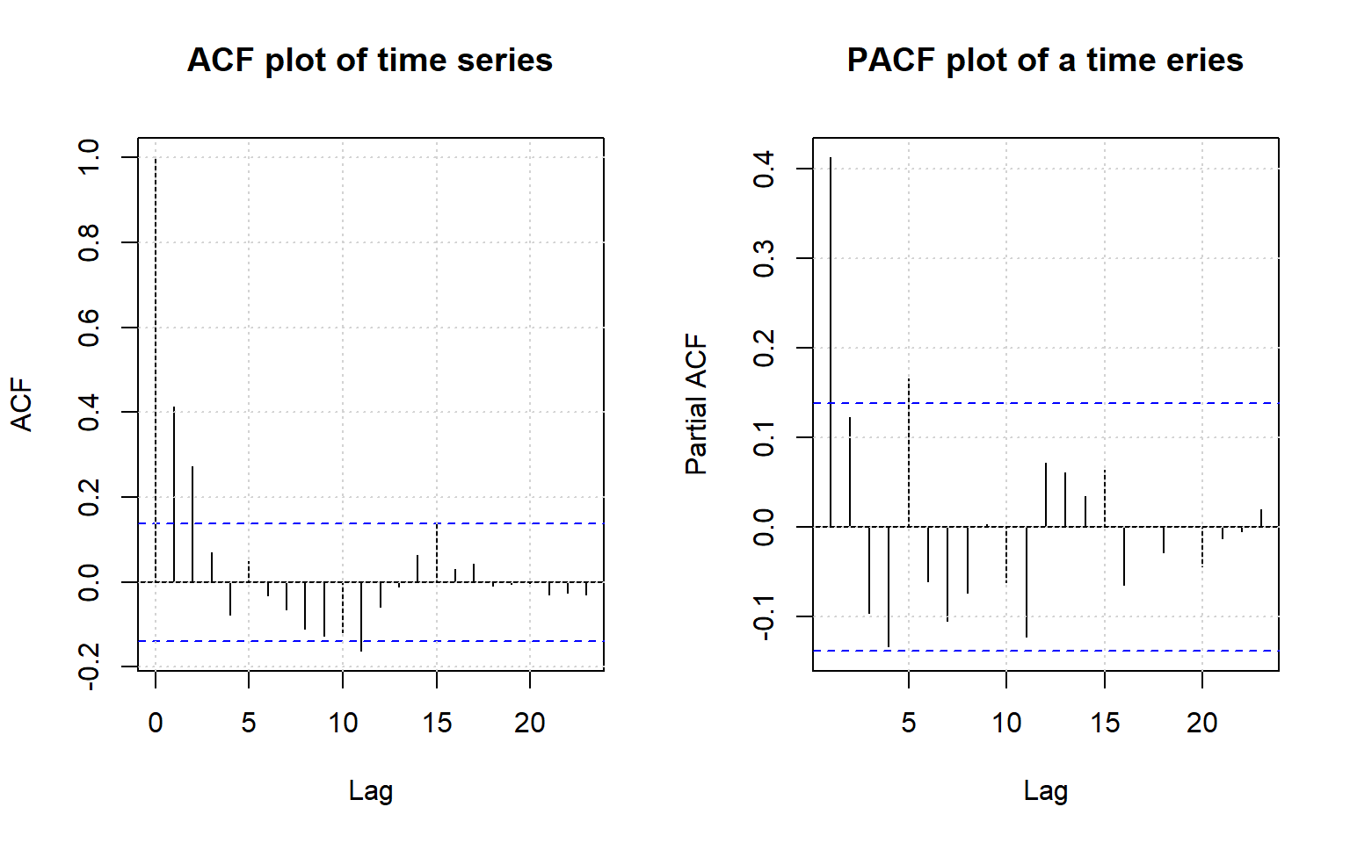
Methodologies/Techniques used
06
Stationary Data example
ACF cuts off after lag 2 and PACF cuts off after lag 1. So three potential (p,q)specification would be (1,0), (1,0), (0,2) and (1,2).

Slide 11
Methodologies/Techniques used
Ridge Regression
06
Ridge regression uses L2 regularisation to weight/penalise residuals when the parameters of a regression model are being learned.
The glmnet package provides the functionality for ridge regression via glmnet(). Important things to know:
Rather than accepting a formula and data frame, it requires a vector input and matrix of predictors.
You must specify alpha = 0 for ridge regression.
Ridge regression involves tuning a hyperparameter, lambda. glmnet() will generate default values.
We use cross-validation to select a good λ value to identify best tuning parameter.
Building a model using this parameter.

Slide 12
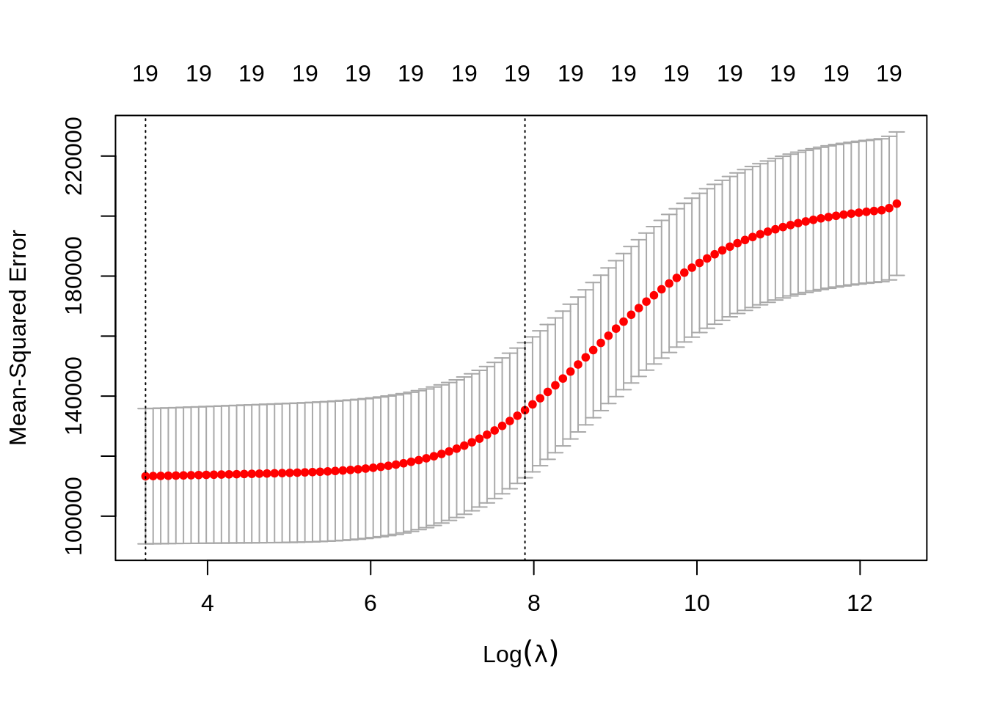
Methodologies/Techniques used
06
The plot displays the cross-validation error according to the log of lambda. The left dashed vertical line indicates that the log of the optimal value of lambda is approximately 2, which is the one that minimizes the prediction error. This lambda value will give the most accurate model.

Slide 13
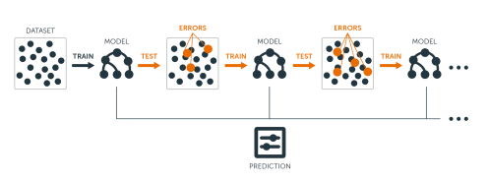
Methodologies/Techniques used
GBM Boosting
06
A Gradient Boosting Machine or GBM combines the predictions from multiple decision trees to generate the final predictions.
Gradient boosting Algorithm involves three elements:
A loss function to be optimized.
Weak learner to make predictions.
An additive model to add weak learners to minimize the loss function.

Slide 14

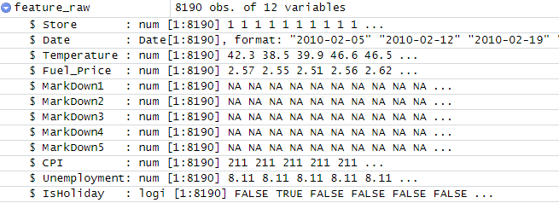
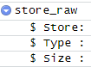
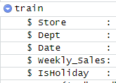
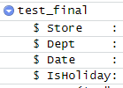
Dataset Explanation
07
The dataset for this project was taken from :
https://www.kaggle.com/c/walmart-recruiting-store-sales-forecasting.
It contains-
stores.csv
features.csv
train.csv
test.csv
Notes:
The dataset for this project was taken from :
https://www.kaggle.com/vik2012kvs/walmart-dataretail-analysis
There are sales data taken from 45 stores of Walmart. This is the data that covers sales from 05-02-2010 to 01-11-2012.
The data contains:
Store - the store number
Date - the week of sales
Weekly_Sales - sales for the given store
Holiday_Flag - whether the week is a special holiday week
Temperature - Temperature on the day of sale
Fuel_Price - Cost of fuel in the region
CPI – Prevailing consumer price index
Unemployment - Prevailing unemployment rate

Slide 15
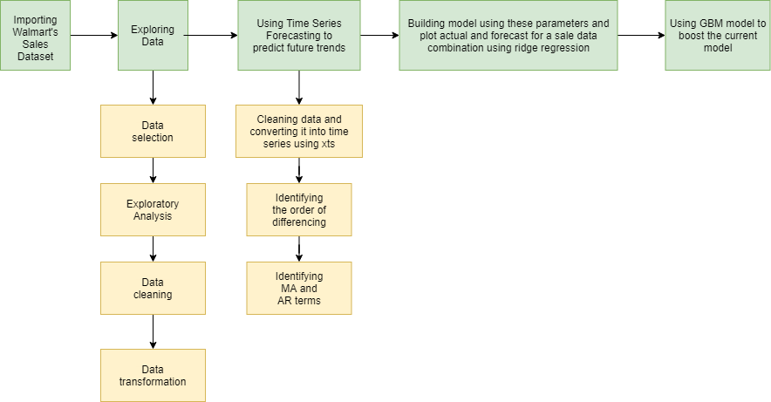
Diagram Flow
08

Slide 16
09
Results
Step 1- Exploring Data and identifying trends, strong and weak dependencies

Slide 17
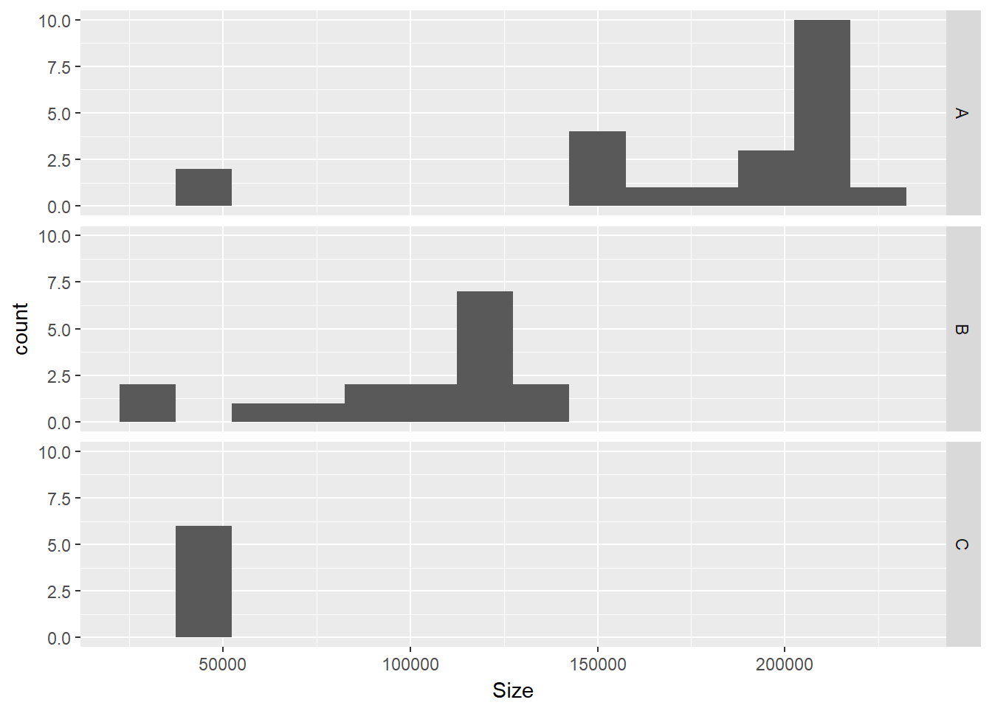
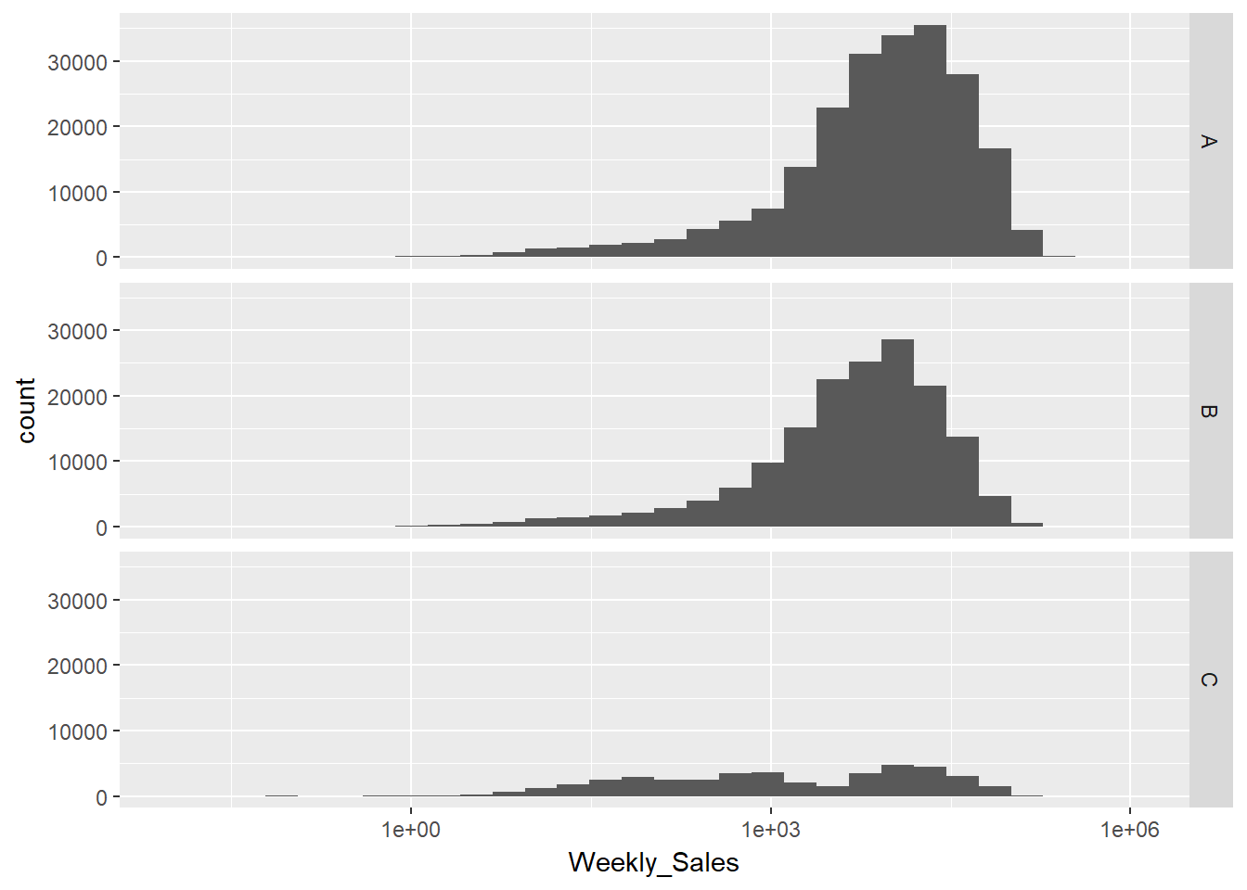
Results (Screenshots, images and graphs)
Fig: Distribution of stores by size and type
Fig: Distribution of sales by type
Notes:
Distribution of stores by size and type Type ‘A’ is the largest format followed by Type ‘B’ and ‘C’. Also, most of the stores in data belong to ‘A’ and ‘B’ type.
Distribution of sales by type Sales for type A and B is normally distributed with left tail being skewed. Hence outlier treatment has to be performed on sales.

Slide 18
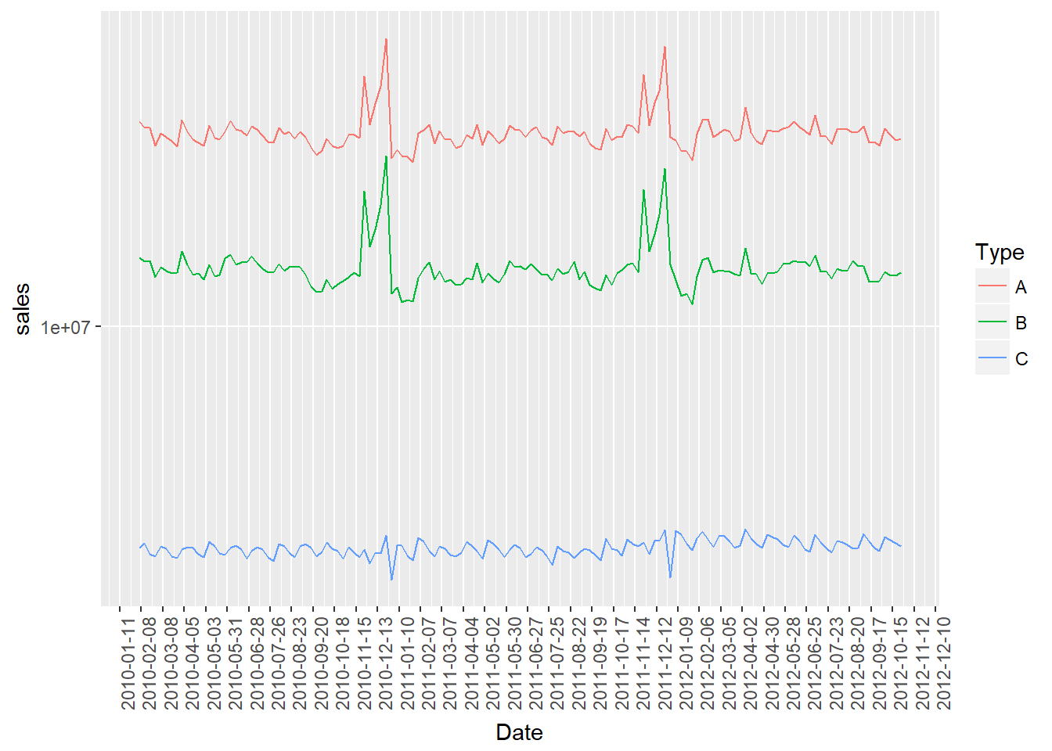
Results (Screenshots, images and graphs)
Fig: Sales by store type
Notes:
Plotting sales by store type to check trend and important peaks/holidays seasonality There are few important peaks visible in the data like ThanksGiving and Christmas. While other small peaks corresspond to Labor day, Easter etc. All the store types follow almost identical seasonality pattern with trend being negligible.

Slide 19
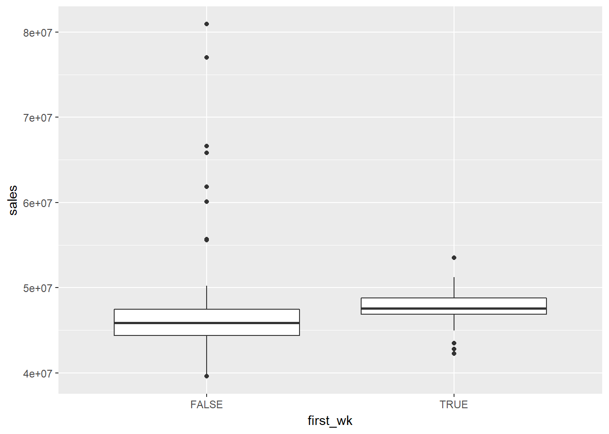
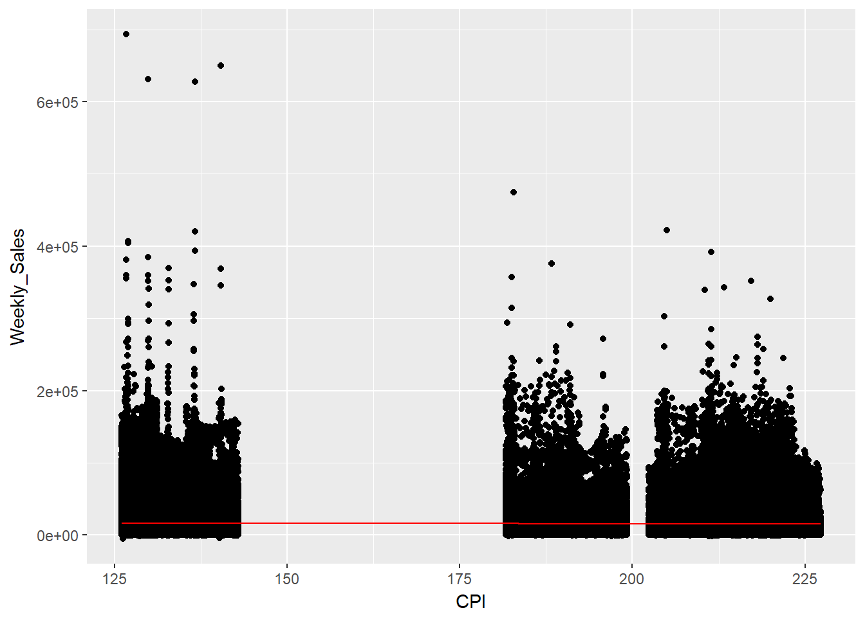
Results (Screenshots, images and graphs)
Fig: Sales trend across month
Fig: Relation between CPI and sales?
Notes:
Sales trend across month True indicates sales at first week. Sales seems to be high at 1st week of the month and then falls slowly in other weeks as indicated by boxplot.Outliers in non-first week resemble the Thanksgiving and Christmas holiday sales.
Is there a relation between CPI and sales? The relation between sales and consumer price index(CPI) is very weak. Sales decreases negligibly with increase in price index.

Slide 20
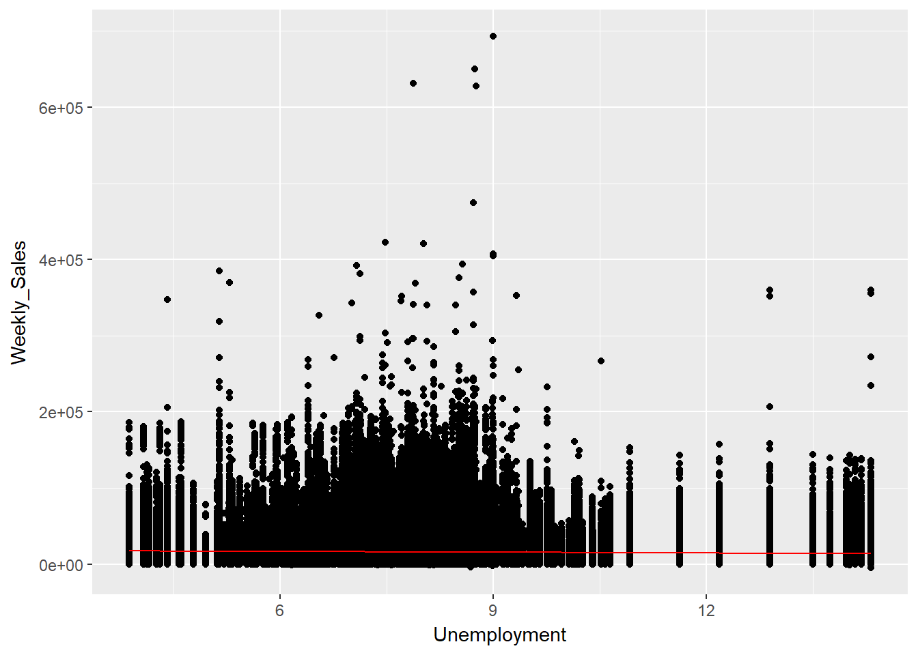
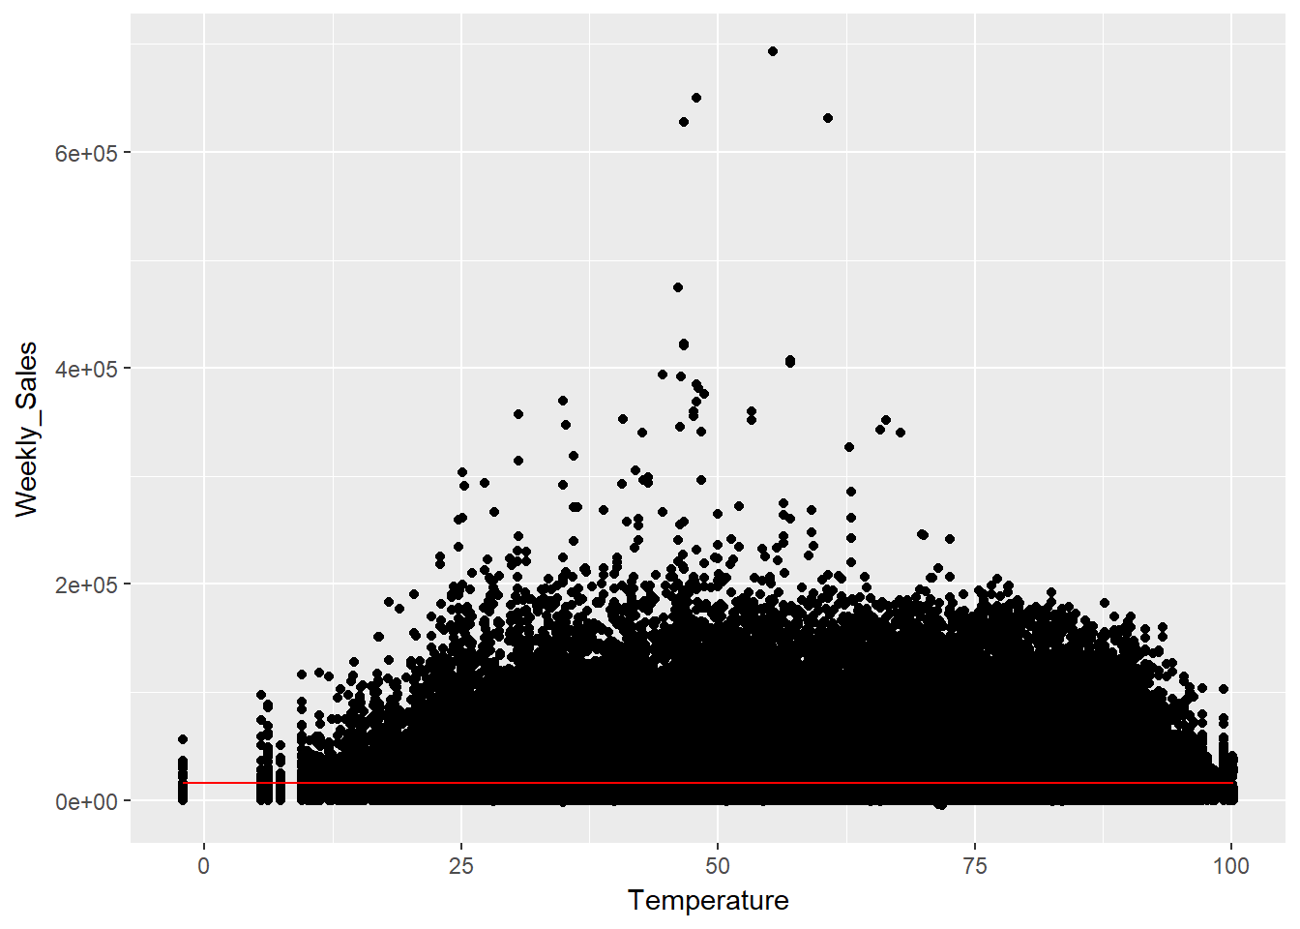
Results (Screenshots, images and graphs)
Fig: Relation between Unemployment and sales?
Fig: Relation between average temperature of the week and sales
Notes:
Is there a relation between Unemployment and sales? Unemployment doesnt affect sales significantly. Initially if we observe at 9 there is no affect on sales but when it comes to 12 Sales reduces slightly at high values of unemployment.
Is there a relation between average temperature of the week and sales? There is no evident relation between the two as can be seen in graph. They doesn’t affect much of sales.

Slide 21
09
Results
Step 2- Data Cleaning and Data transformation

Slide 22
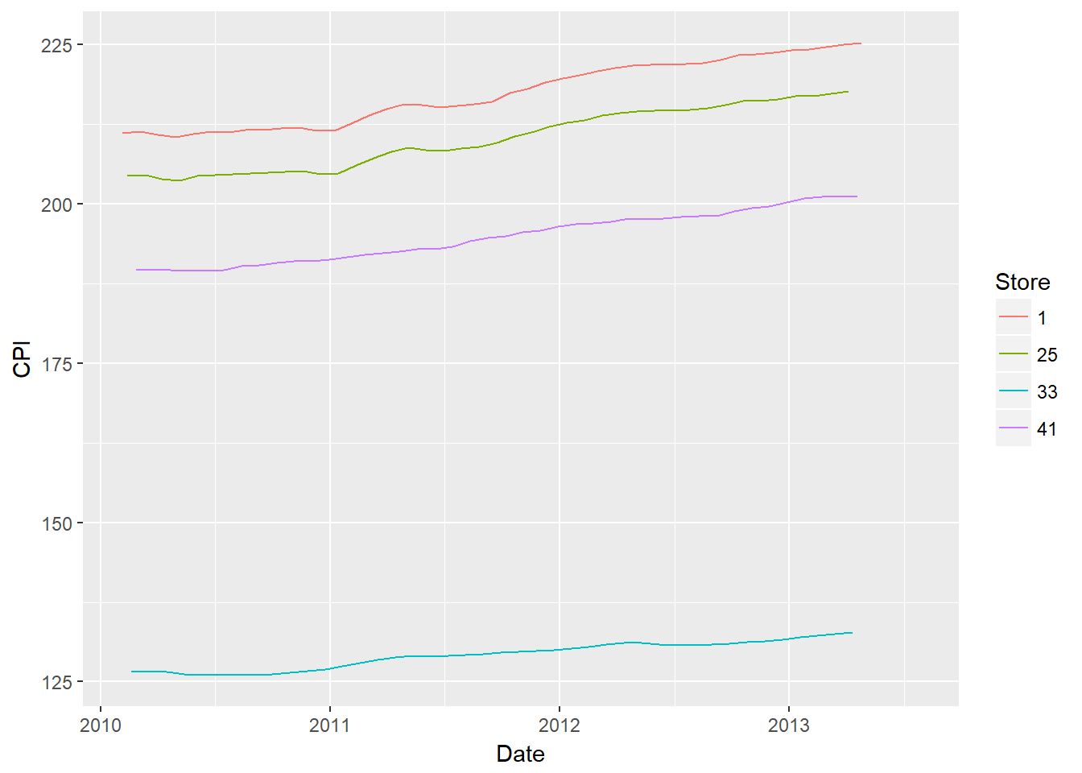
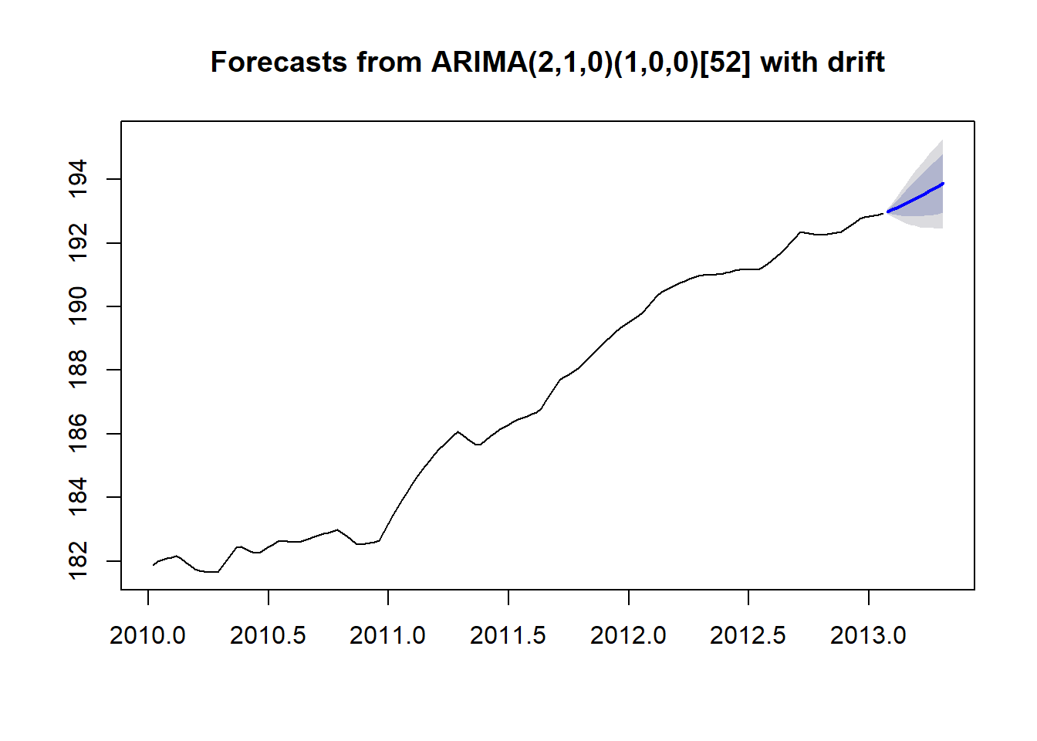
Results (Screenshots, images and graphs)
AFTER
BEFORE
Notes:
Missing CPI treatment CPI is missing for few dates in test period from 3rd May 2013 to 26th July 2013. Checking trend of CPI for few random stores.
AFTER- CPI seems to follow a good trend which can be forecasted using time series method. Thus, forecasting CPI using auto ARIMA for the missing weeks. The plot of actual along with forecast looks fine for random store.

Slide 23
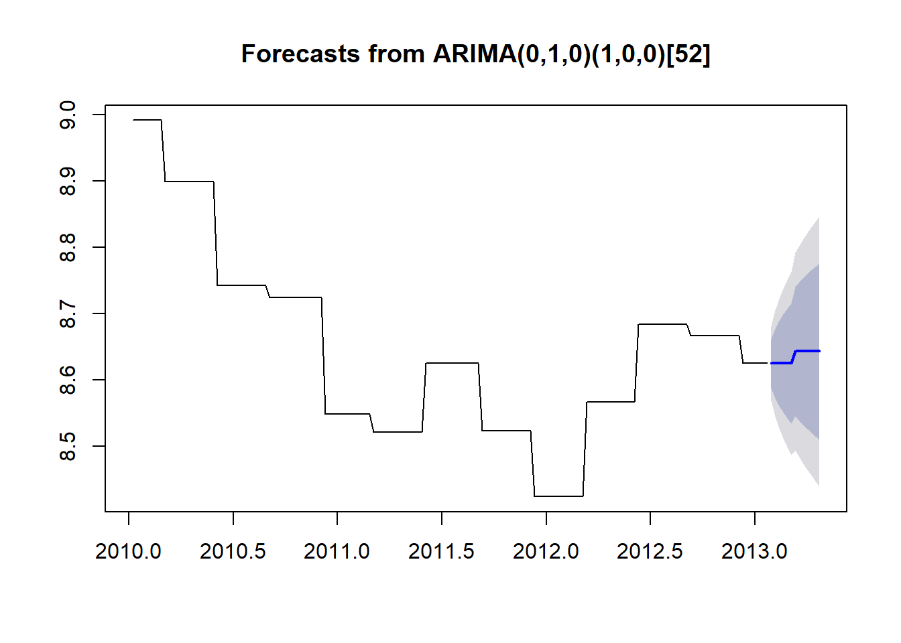
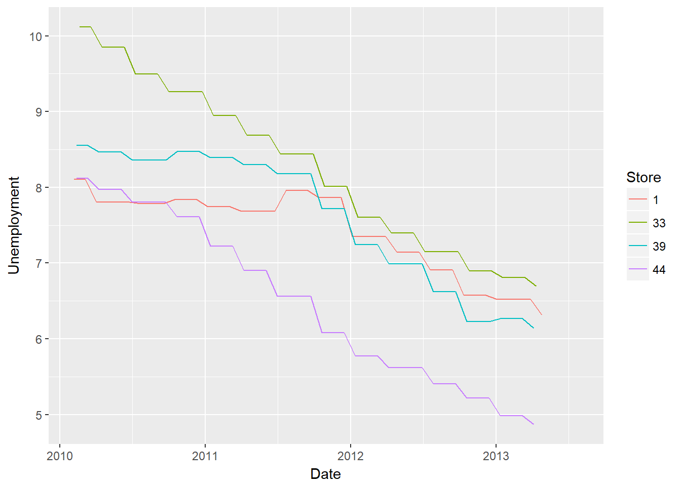
Results (Screenshots, images and graphs)
BEFORE
AFTER
Notes:
Missing Unemployment treatment Unemployment is missing for few dates in test period from 3rd May 2013 to 26th July 2013. Checking trend of Unemployment for few random stores.
We will forecast Unemployment using time series method i.e. auto ARIMA for the missing weeks. The plot of actual along with forecast looks fine for random store.

Slide 24
09
Results
Step 3- Building Model using ARIMA, Ridge Regression and GBM

Slide 25
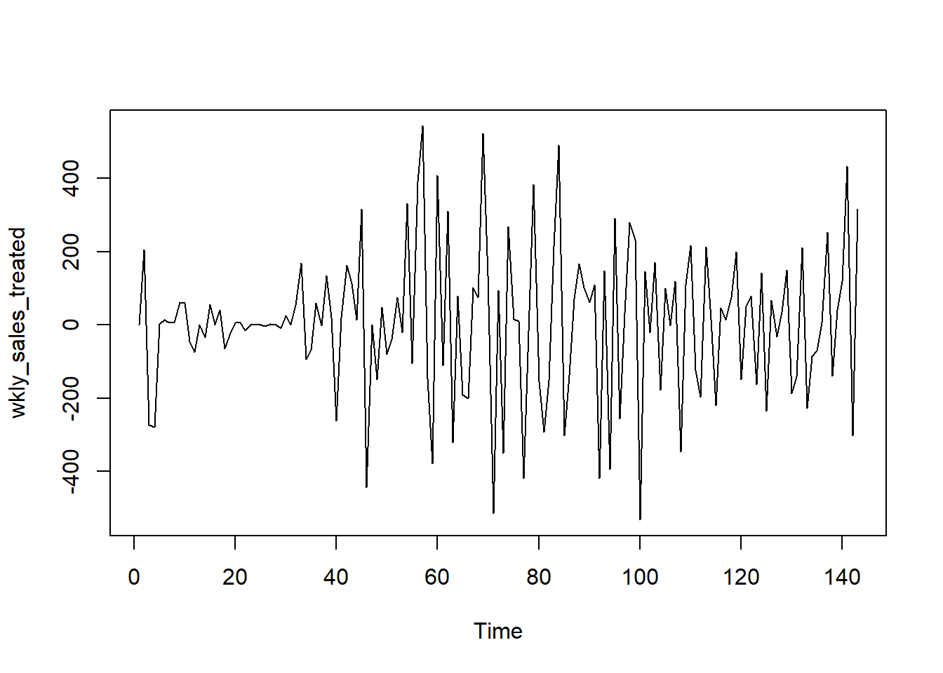
Results (Screenshots, images and graphs)
Fig: Identifying the order of differencing
Notes:
1. Identifying the order of differencing. We will difference the time series and conduct augmented Dickey-Fuller test to check for stationarity. The differencing of order 1 leads to stationary series.

Slide 26
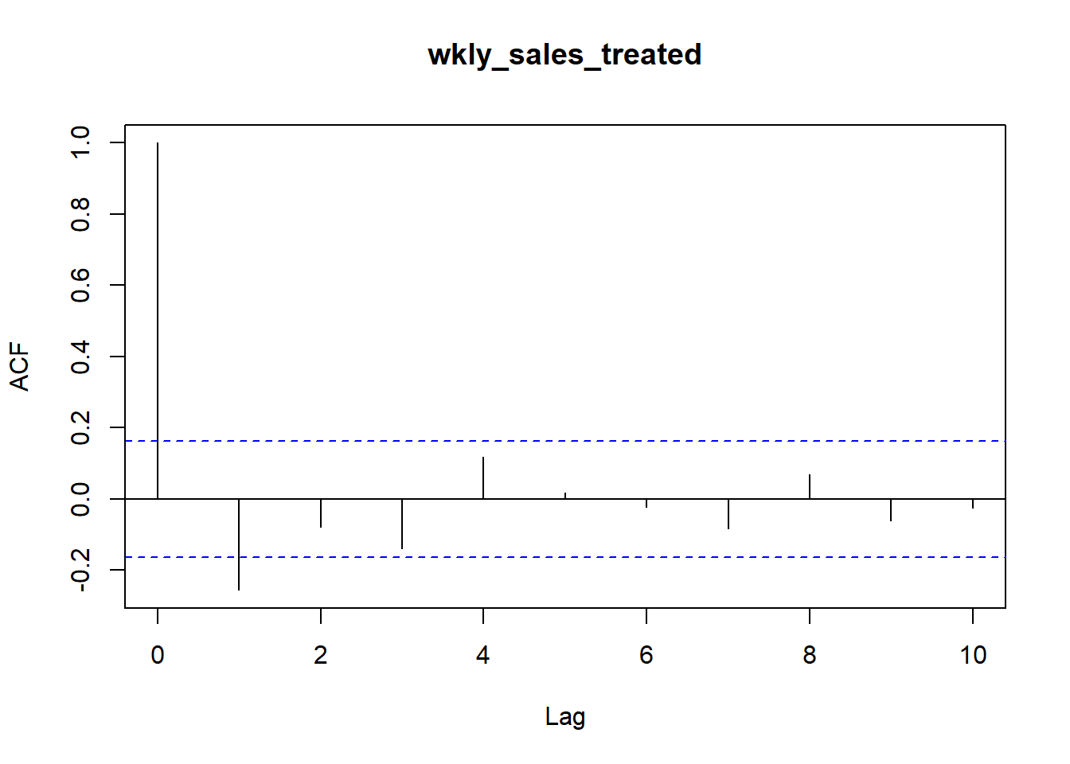
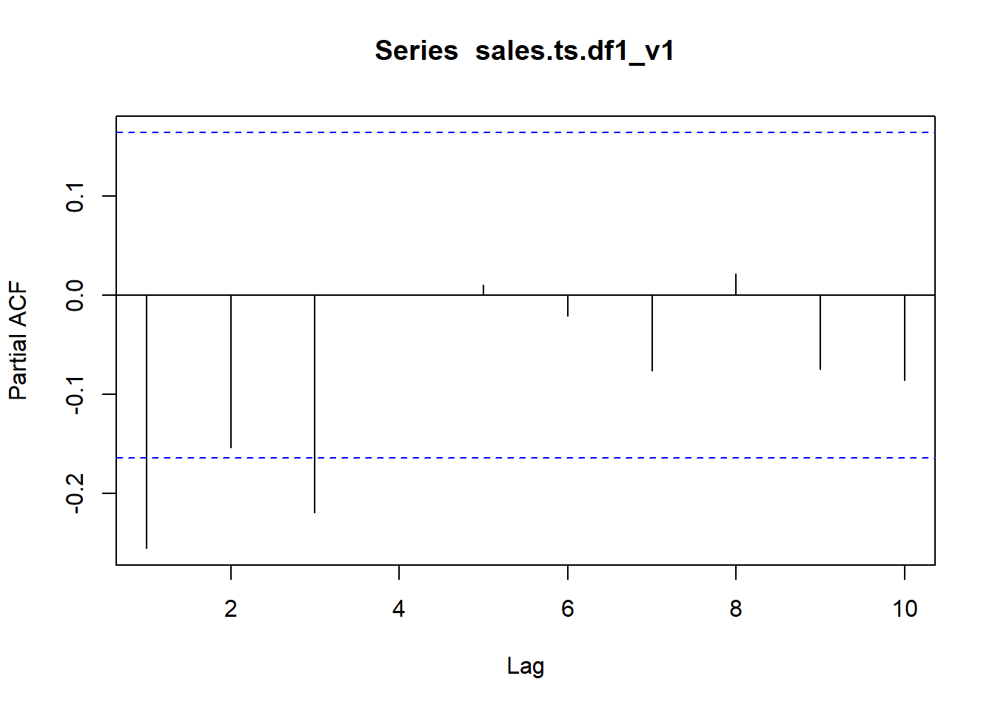
Results (Screenshots, images and graphs)
Fig: Identifying MA=3
Fig: Identifying AR=1
Notes:
2. Identifying MA and AR terms. We will use this differenced series to plot ACF and PACF plots and find the AR and MA terms. Cut off of ACF at lag 1 indicates AR term i.e. p = 1.

Slide 27
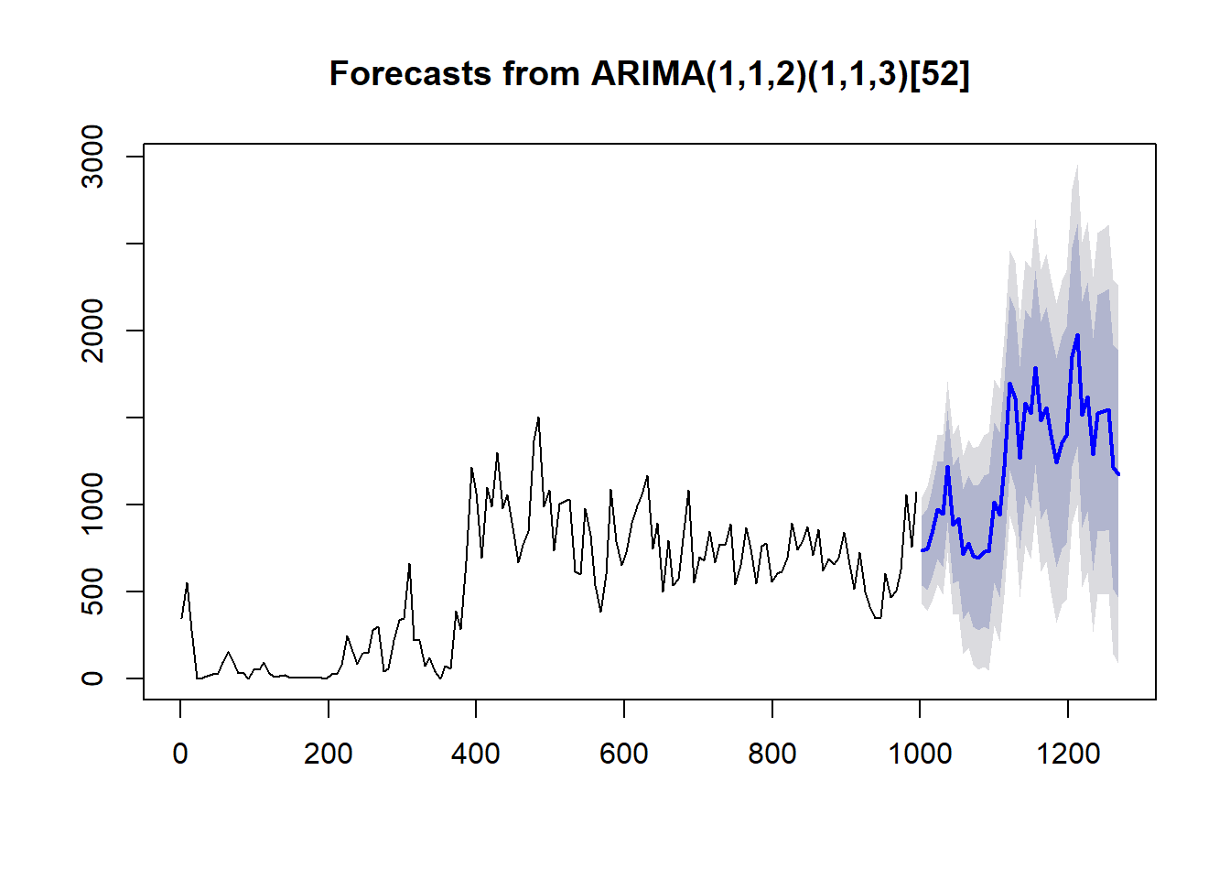
Results (Screenshots, images and graphs)
Fig: Predicting future trends
Notes:
plotting actuals + forecast for a sample store-dept combination and predicting future trends.

Slide 28
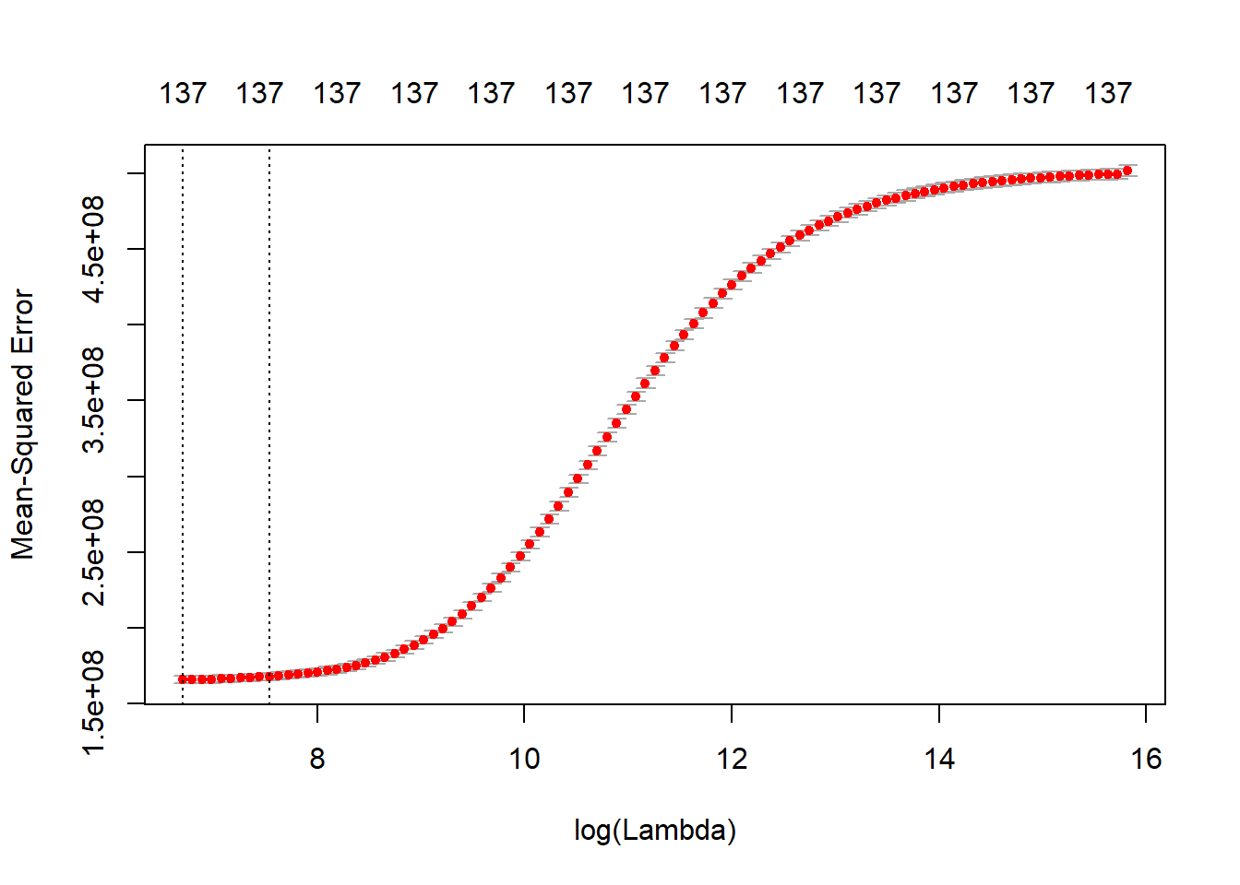
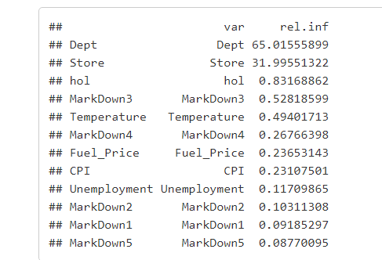
Results (Screenshots, images and graphs)
Fig: Cross Validation to identify best tuning parameter
Fig: Predictions after boosting using GBM
Notes:
Cross validation to identify best tuning parameter. The tuning parameter for lowest cross validation error is 823.10.

Slide 29
10
Code Execution

Slide 30

12
Conclusion

Slide 31
References
11
[1] Pavlyshenko, Bohdan M. “Machine-Learning Models for Sales Time Series Forecasting.” Mpdi, 18 Jan. 2019, pp. 2–11., doi:doi:10.3390/data4010015.
[2] Chandel, Archisha, et al. “Sales Prediction System Using Machine Learning .” International Journal of Scientific Research and Engineering Development, vol. 2, no. 2, Apr. 2019, pp. 667–670.
[3] Hariyani, Mr. (2020). An Effective Approach for Sales Forecasting. International Journal for Research in Applied Science and Engineering Technology. 8. 2109-2025. 10.22214/ijraset.2020.5329.
[4] Cheriyan, Sunitha, and Saju Mohanan. “Intelligent Sales Prediction Using Machine Learning Techniques.” Aug. 2018, pp. 53–58., doi:DOI: 10.1109/iCCECOME.2018.8659115.

